Slide 1
ISO nWIP
ISO/TC 37 Annual Forum Brussels 11th June 2023
A Standard Notation for
Business Reports
Pre-expert draft
Dr. Jürgen Faisst AND Diego berea ibcs Association

Slide 2
INDEX OF CONTENTS
Why an ISO NWIP for report notation based on IBCS?
What is IBCS?
Examples from NWIP Pre-Expert Draft https://sd.iso.org/documents/open/8a8f2d93-32be-4b01-ac02-af3d3c30a786
Q/A
Is this initiative of interest to ISO/TC37?

Slide 3
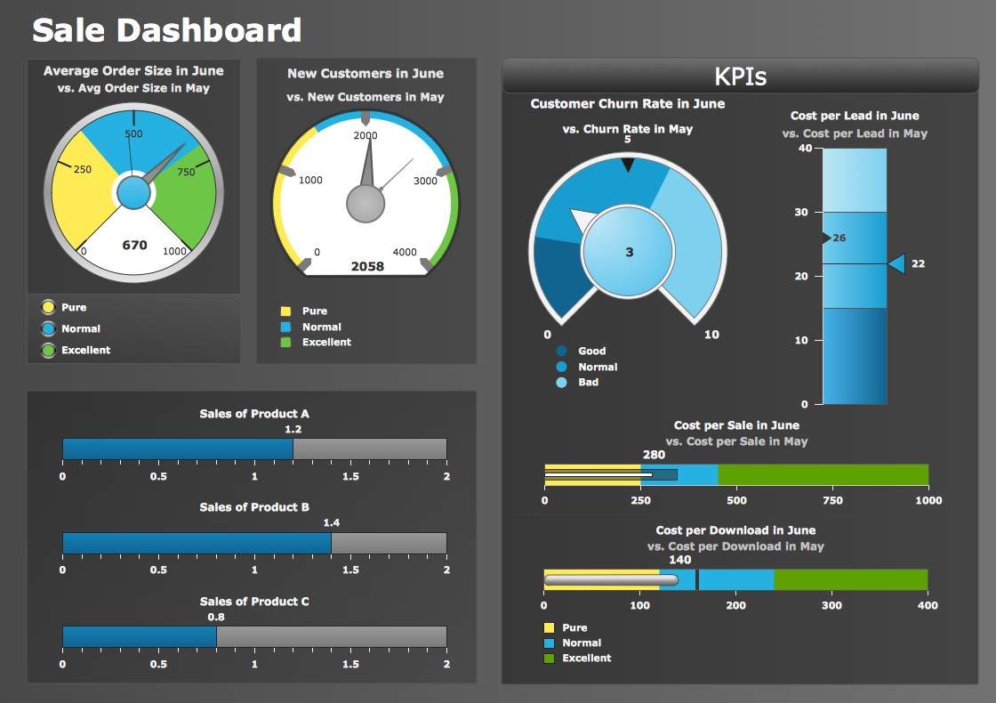

Slide 4
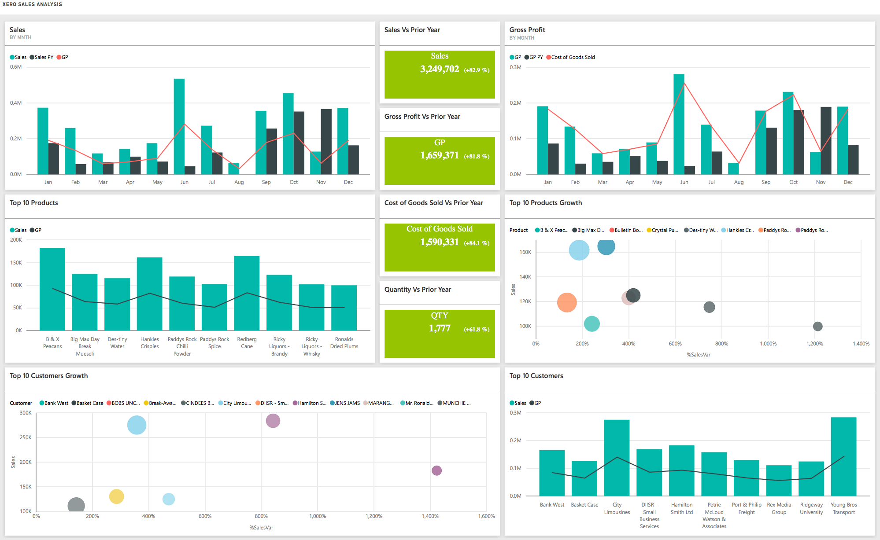

Slide 5
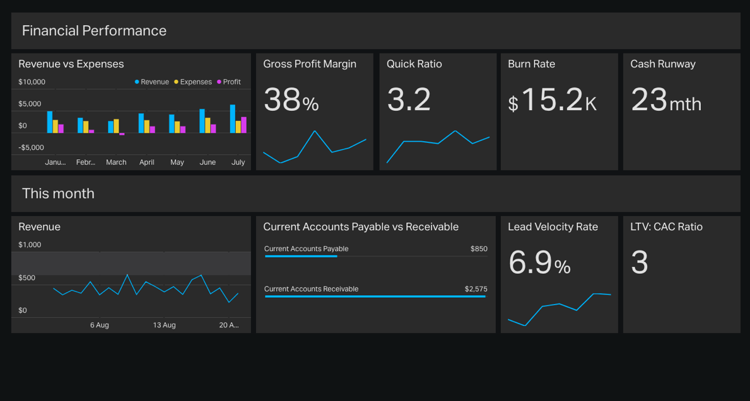

Slide 6
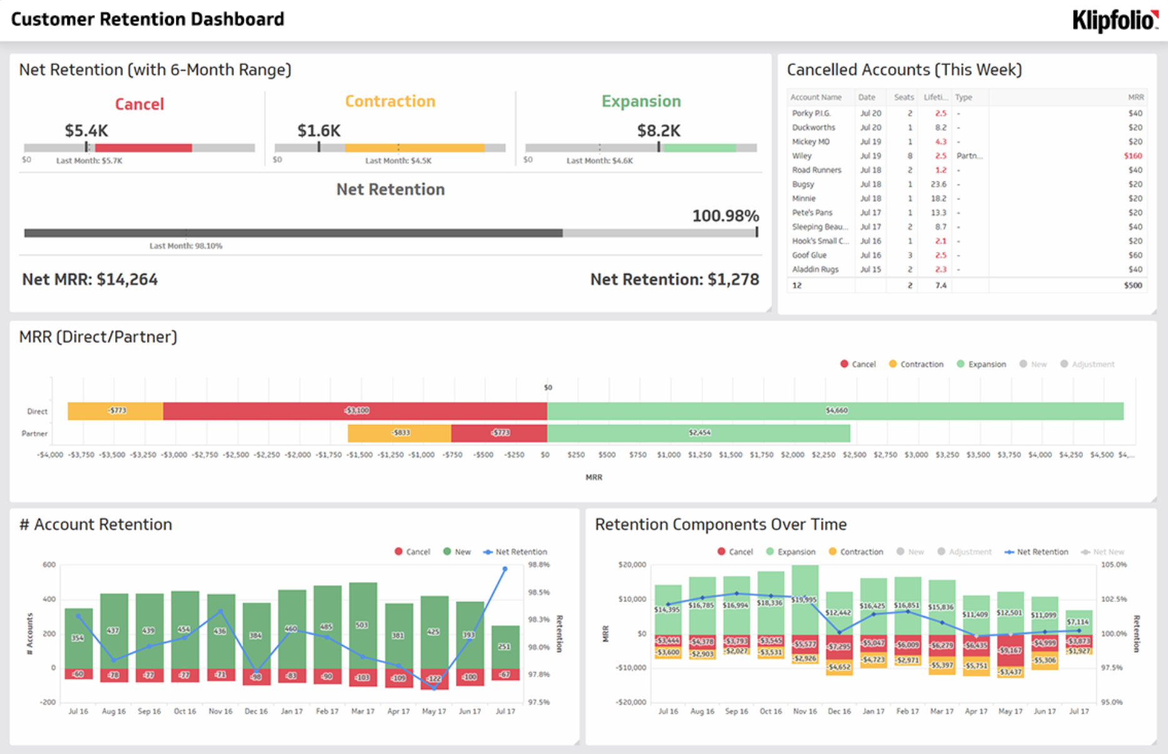

Slide 7
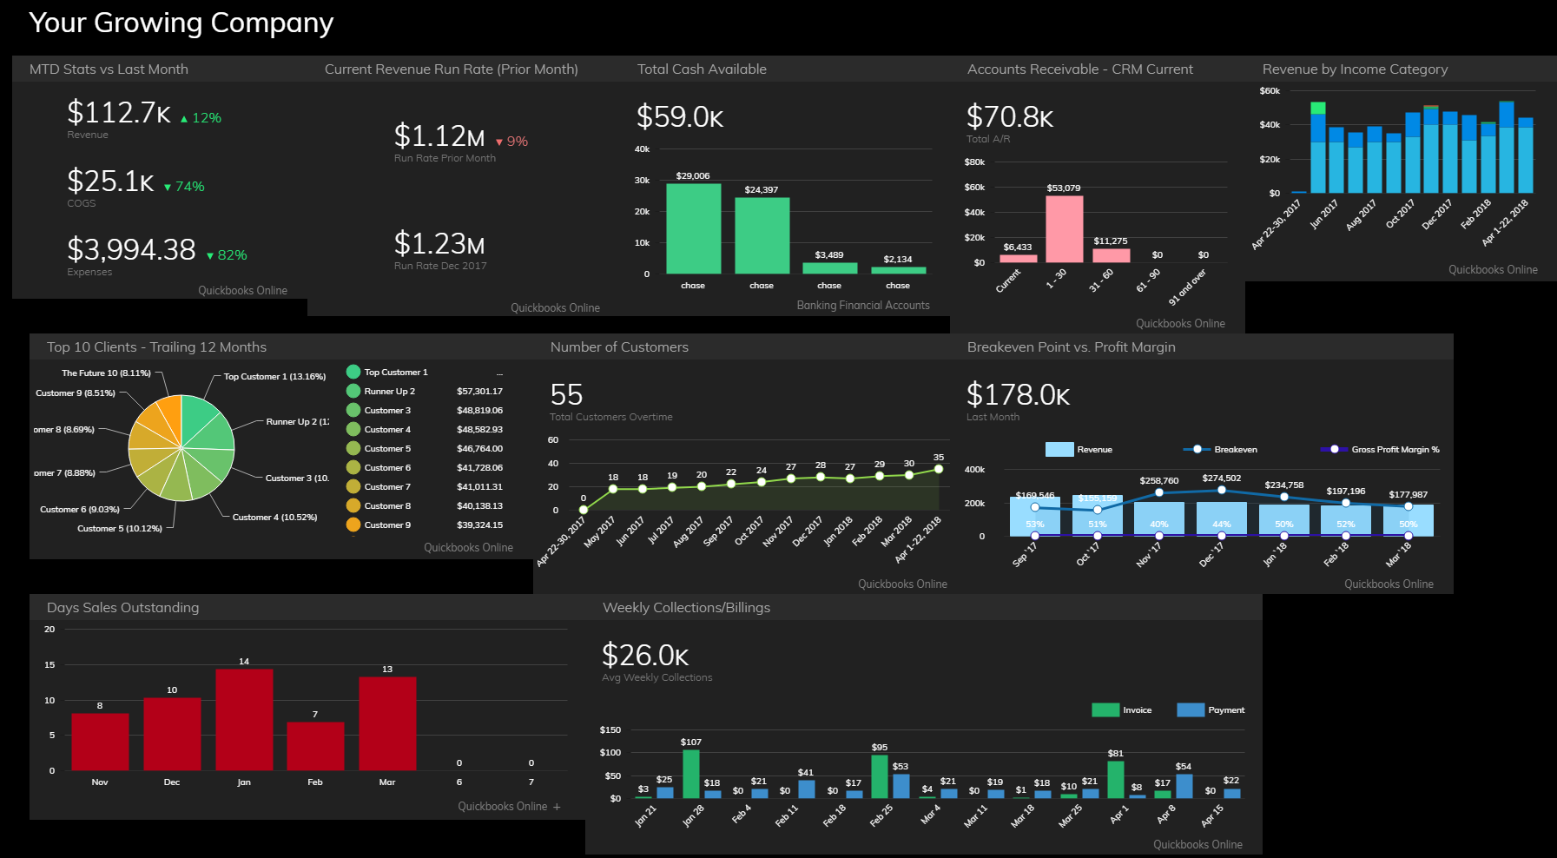

Slide 8
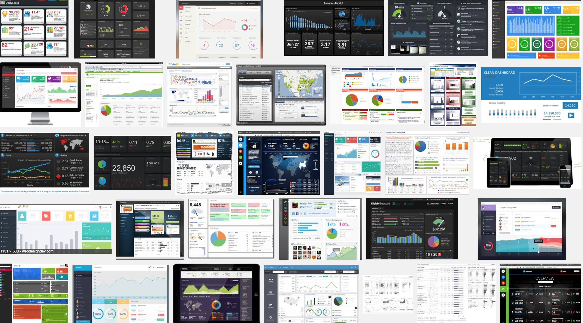

Slide 9
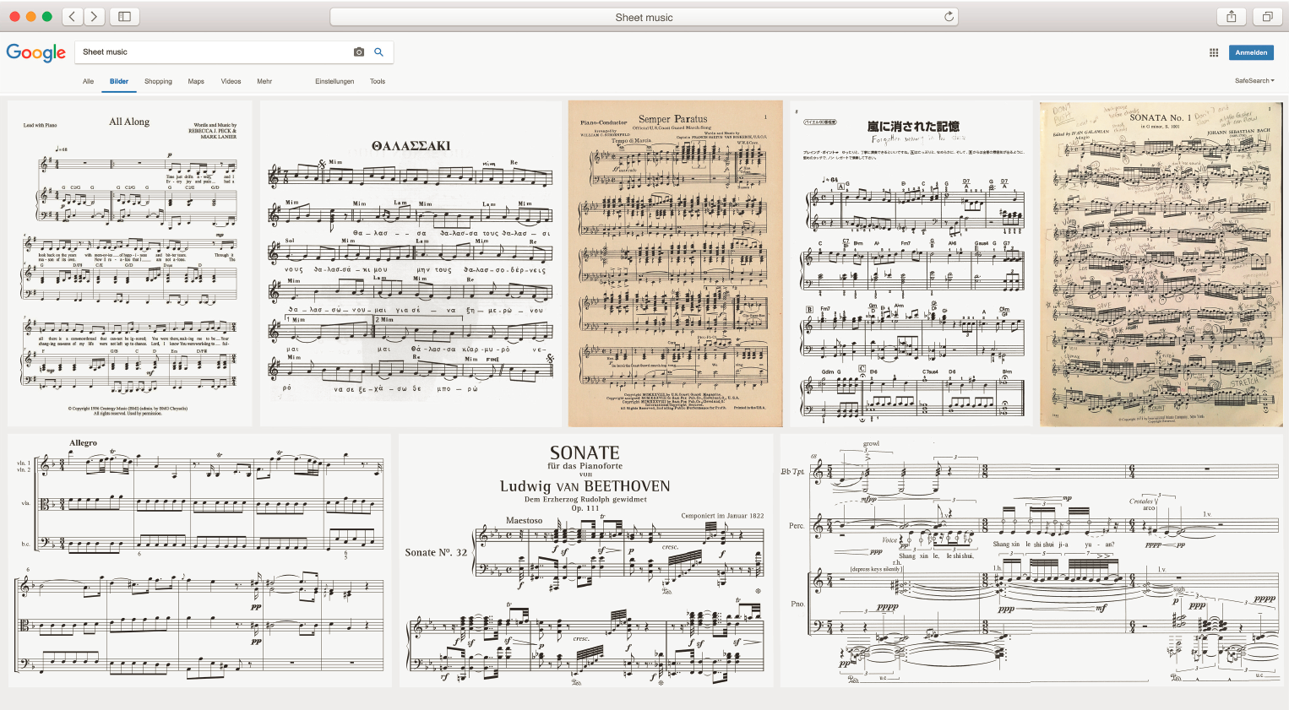
www.ibcs.com

Slide 10
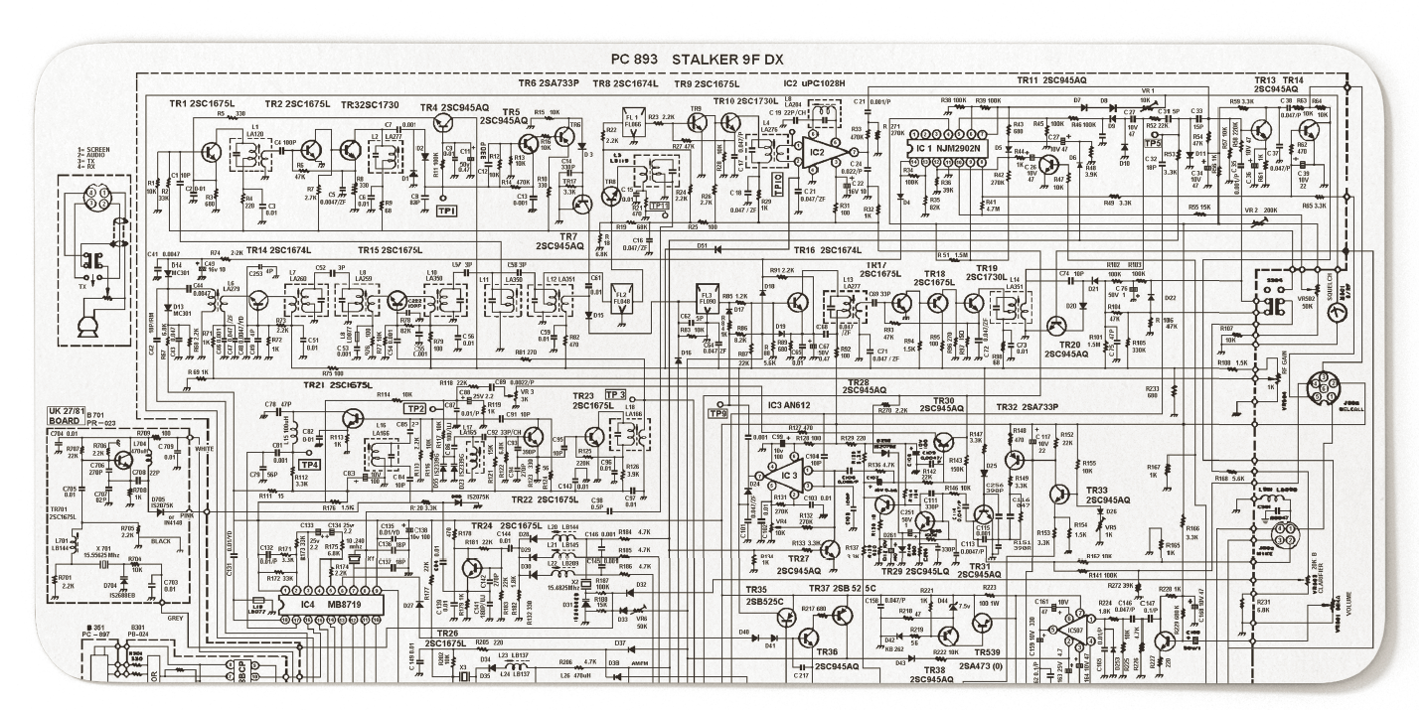
Source: Teaberry Stalker IX Service Manual
www.ibcs.com

Slide 11
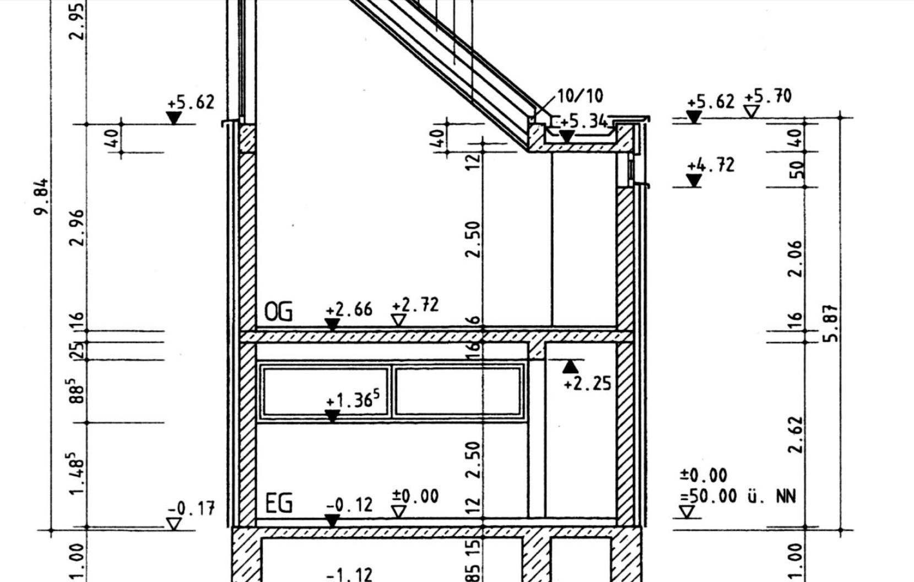

Slide 12
?

Slide 13
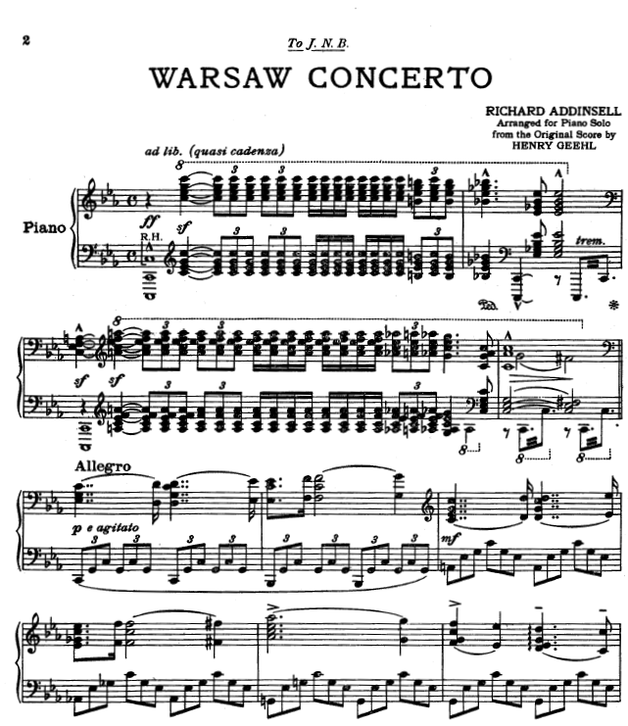
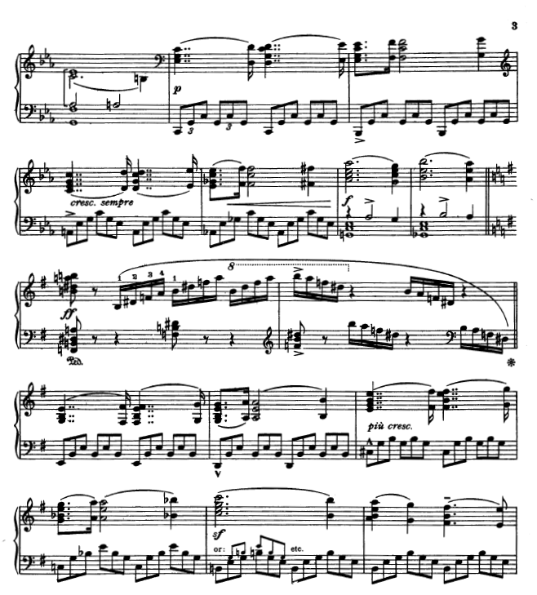

Slide 14
Source: Tata investor presentation 2016, wwwtatacommunications.com

Slide 15
If we want to make business communication more effective, then things that mean the same have to look the same.
”
Prof. Rolf Hichert IBCS Association

Slide 16
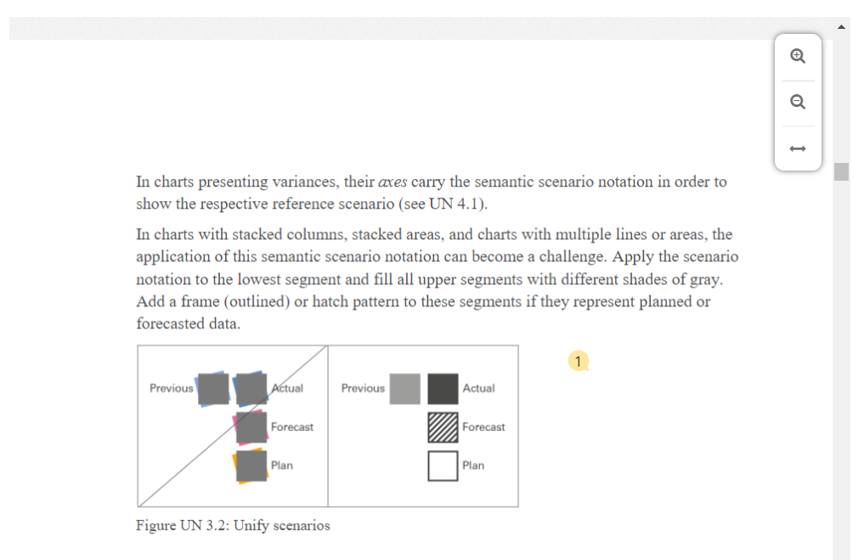
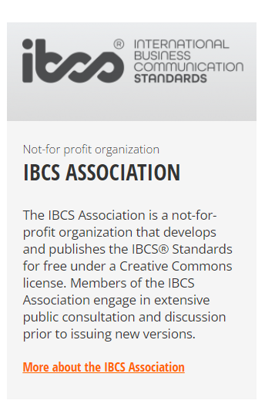

Slide 17
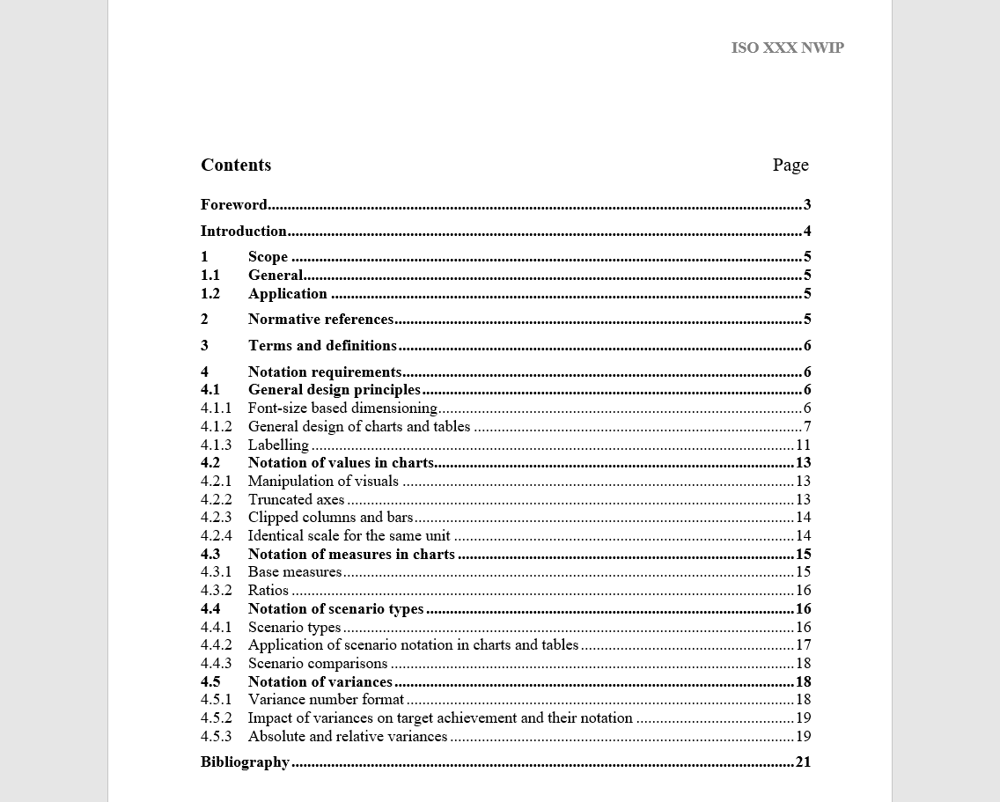

Slide 18
Unified titles shall identify the content of pages, charts, and tables.
1
www.ibcs.com

Slide 19
Unified titles shall identify the content of pages, charts, and tables: Who (entity)
1
www.ibcs.com

Slide 20
Unified titles shall identify the content of pages, charts, and tables: Who (entity), what (measure)
1
www.ibcs.com

Slide 21
Unified titles shall identify the content of pages, charts, and tables: Who (entity), what (measure), and when (time period).
1
www.ibcs.com

Slide 22
Example
Alpha Corporation
© www.ibcs.com

Slide 23
Example
Alpha Corporation
Net sales in mUSD
© www.ibcs.com

Slide 24
Example
Alpha Corporation
Net sales in mUSD
2023
© www.ibcs.com

Slide 25
Time series (ordinal scales) shall consistently be displayed on a horizontal axes, whereas nominally scaled structure categories shall be displayed on a vertical axis.
2
www.ibcs.com

Slide 26
Example
Alpha Corporation
Net sales in mUSD
2023
© www.ibcs.com

Slide 27
Example
Alpha Corporation
Net sales in mUSD
2023
© www.ibcs.com

Slide 28
Example
Alpha Corporation
Net sales in mUSD
2023
AC
783
Jan
© www.ibcs.com

Slide 29
Example
Alpha Corporation
Net sales in mUSD
2023
AC
783
749
Jan
Feb
© www.ibcs.com

Slide 30
Example
Alpha Corporation
Net sales in mUSD
2023
AC
783
827
749
Jan
Feb
Mar
© www.ibcs.com

Slide 31
Example
Alpha Corporation
Net sales in mUSD
2023
AC
783
Jan
Feb
Mar
Apr
May
Jun
Jul
Aug
Sep
Oct
Nov
Dec
© www.ibcs.com

Slide 32
Example
Alpha Corporation
Net sales in mUSD
2023
AC
783
749
Jan
Feb
Mar
Apr
May
Jun
Jul
Aug
Sep
Oct
Nov
Dec
© www.ibcs.com

Slide 33
Example
Alpha Corporation
Net sales in mUSD
2023
AC
783
827
749
Jan
Feb
Mar
Apr
May
Jun
Jul
Aug
Sep
Oct
Nov
Dec
© www.ibcs.com

Slide 34
Example
Alpha Corporation
Net sales in mUSD
2023
AC
899
827
844
809
783
749
715
710
685
601
627
572
Jan
Feb
Mar
Apr
May
Jun
Jul
Aug
Sep
Oct
Nov
Dec
© www.ibcs.com

Slide 35
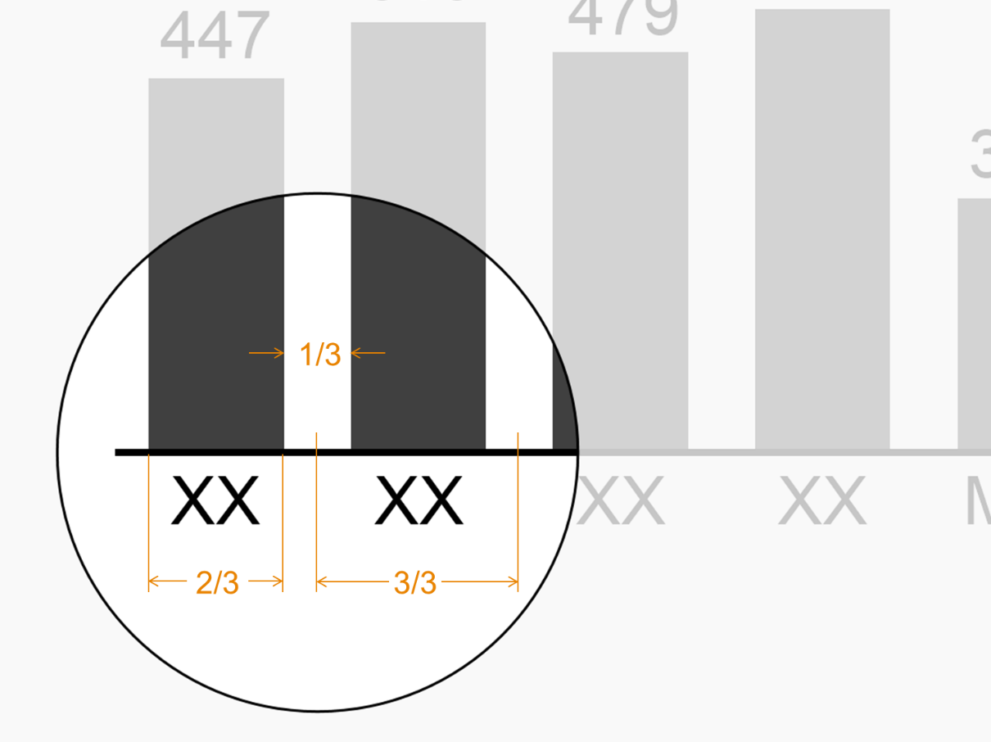
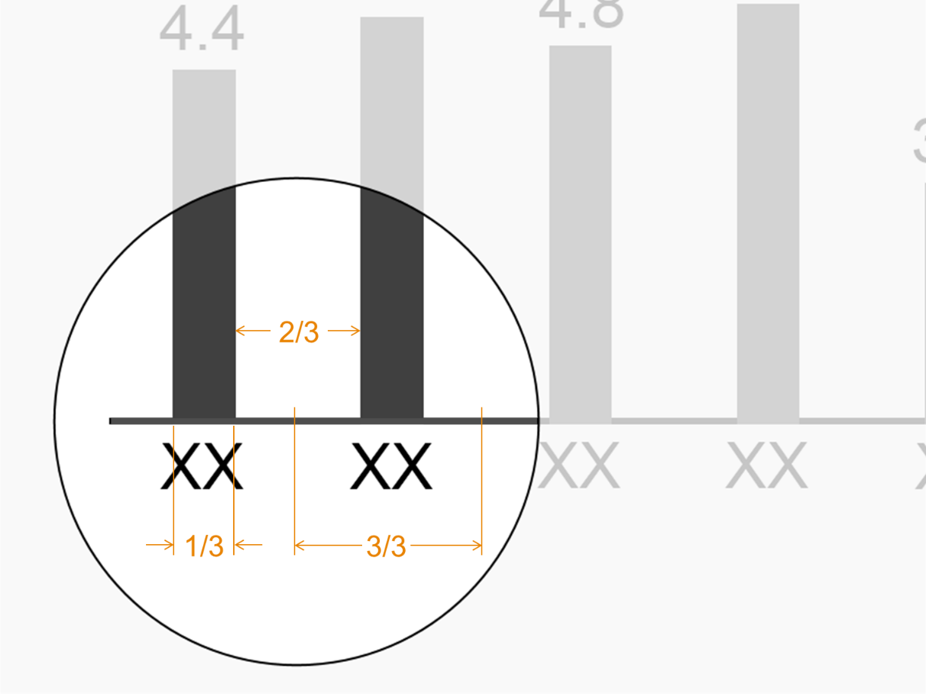
Base measures shall be indicated by a column width of 2/3 of the category width, whereas ratios shall be indicated by a column width of 1/3.
3
www.ibcs.com

Slide 36
Example
Alpha Corporation
Net sales in mUSD
2023
AC
899
827
844
809
783
749
715
710
685
601
627
572
Jan
Feb
Mar
Apr
May
Jun
Jul
Aug
Sep
Oct
Nov
Dec
© www.ibcs.com

Slide 37
Example
Alpha Corporation
Net sales per head in kUSD
2023
AC
899
827
844
809
783
749
715
710
685
601
627
572
Jan
Feb
Mar
Apr
May
Jun
Jul
Aug
Sep
Oct
Nov
Dec
© www.ibcs.com

Slide 38
Example
Alpha Corporation
Net sales in mUSD
2023
AC
899
827
844
809
783
749
715
710
685
601
627
572
Jan
Feb
Mar
Apr
May
Jun
Jul
Aug
Sep
Oct
Nov
Dec
© www.ibcs.com

Slide 39
Legends and labels shall be integrated to reduce eye movement and save colour for more important purposes.
4
www.ibcs.com

Slide 40
Example
Alpha Corporation
Net sales in mUSD
2023
AC
899
827
844
809
783
749
715
710
685
601
627
572
Jan
Feb
Mar
Apr
May
Jun
Jul
Aug
Sep
Oct
Nov
Dec
© www.ibcs.com

Slide 41
Example
Alpha Corporation
Net sales in mUSD
2023
899
827
844
809
783
749
715
710
685
601
627
572
AC
Jan
Feb
Mar
Apr
May
Jun
Jul
Aug
Sep
Oct
Nov
Dec
© www.ibcs.com

Slide 42
Scenarios shall be identified by fill patterns.
5
www.ibcs.com

Slide 43
Scenarios shall be identified by fill patterns.
5
www.ibcs.com

Slide 44
Scenarios shall be identified by fill patterns.
5
www.ibcs.com

Slide 45
Scenarios shall be identified by fill patterns.
5
www.ibcs.com

Slide 46
Scenarios shall be identified by fill patterns.
5
www.ibcs.com

Slide 47
Example
Alpha Corporation
Net sales in mUSD
2023
899
827
844
809
783
749
715
710
685
601
627
572
AC
Jan
Feb
Mar
Apr
May
Jun
Jul
Aug
Sep
Oct
Nov
Dec
© www.ibcs.com

Slide 48
Example
Alpha Corporation
Net sales in mUSD
2023
899
827
844
809
783
749
715
710
685
601
627
572
PL
AC
Jan
Feb
Mar
Apr
May
Jun
Jul
Aug
Sep
Oct
Nov
Dec
© www.ibcs.com

Slide 49
Example
Alpha Corporation
Net sales in mUSD
2023
899
827
844
809
AC
783
749
715
710
685
601
627
572
FC
PL
Jan
Feb
Mar
Apr
May
Jun
Jul
Aug
Sep
Oct
Nov
Dec
© www.ibcs.com

Slide 50
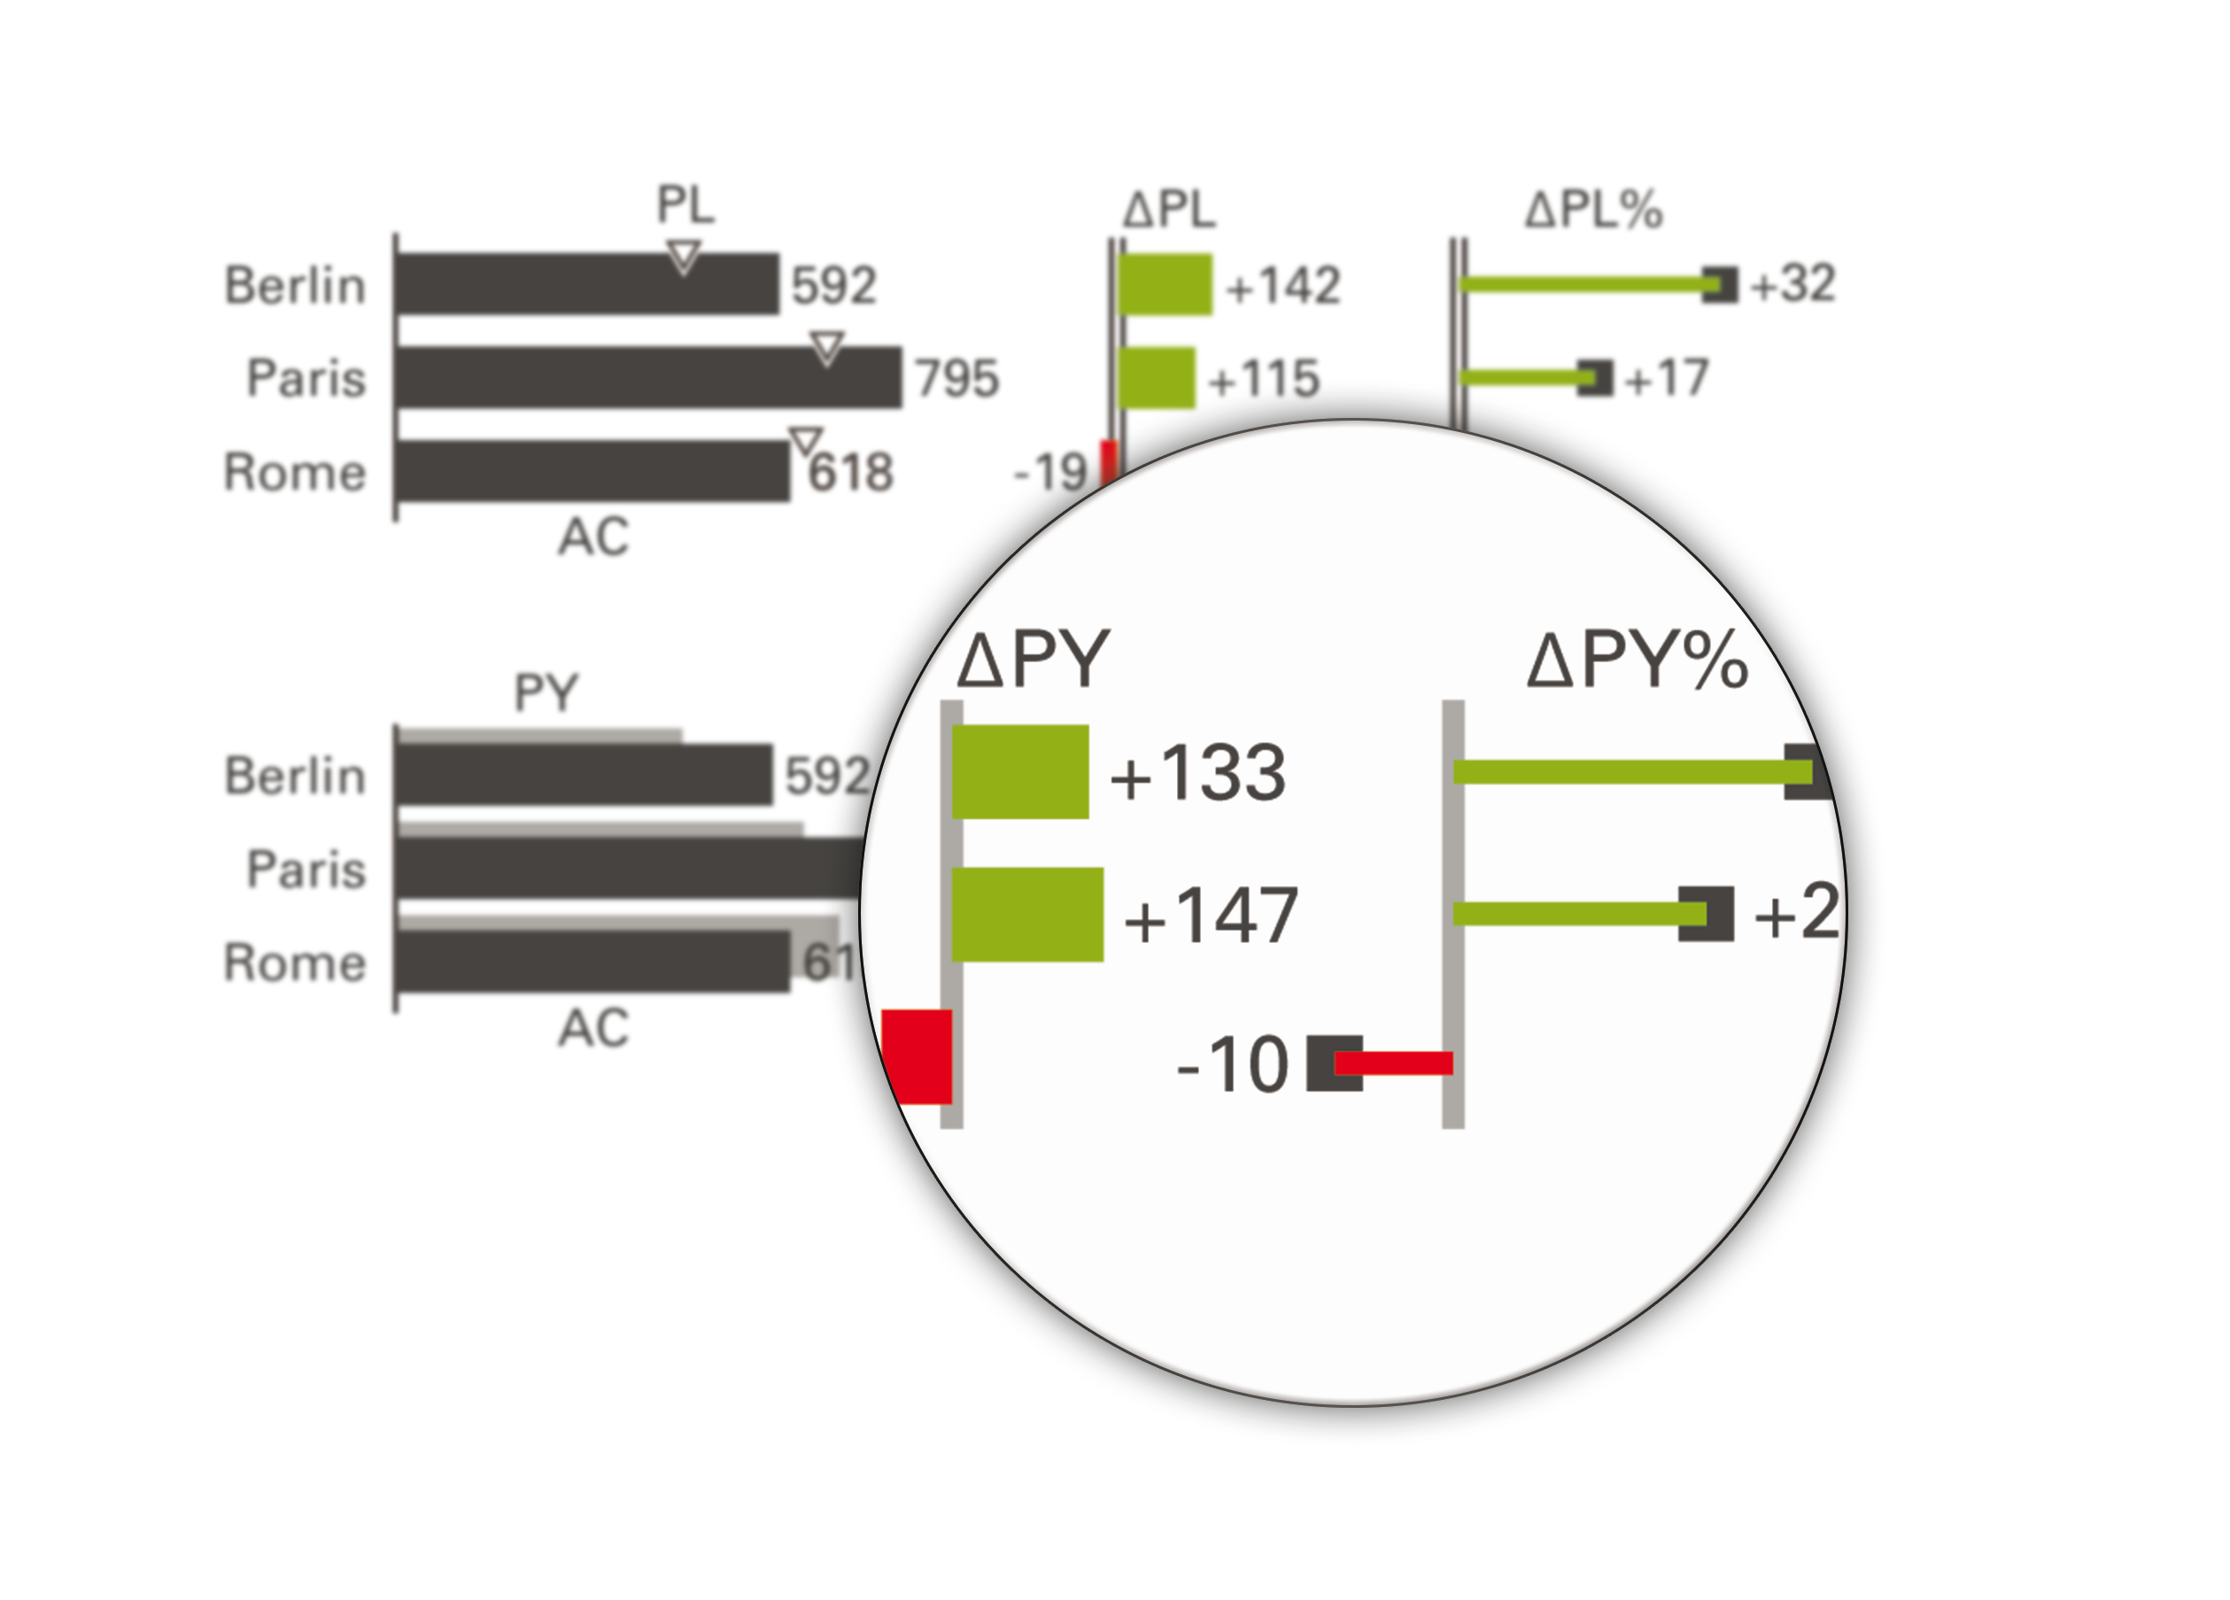
Good and bad variances shall be highlighted with green and red color.
6
www.ibcs.com

Slide 51
Good and bad variances shall be highlighted with green and red color. Relative variances shall be indicated by pins.
6
www.ibcs.com

Slide 52
Example
Alpha Corporation
Net sales in mUSD
2023
899
827
844
809
AC
783
749
715
710
685
601
627
572
FC
PL
Jan
Feb
Mar
Apr
May
Jun
Jul
Aug
Sep
Oct
Nov
Dec
© www.ibcs.com

Slide 53
Example
Alpha Corporation
Net sales in mUSD
2023
+30
+65
+96
+157
+59
ΔPL
+23
+37
-44
-5
+85
-140
-131
899
827
844
809
AC
783
749
715
710
685
601
627
572
FC
PL
Jan
Feb
Mar
Apr
May
Jun
Jul
Aug
Sep
Oct
Nov
Dec
© www.ibcs.com

Slide 54
Example
Alpha Corporation
Net sales in mUSD
2023
+33
+13
+12
+8
+12
+3
+5
+4
ΔPL%
-1
-6
-19
-18
+30
+65
+96
+157
+59
ΔPL
+23
+37
-44
-5
+85
-140
-131
899
827
844
809
AC
783
749
715
710
685
601
627
572
FC
PL
Jan
Feb
Mar
Apr
May
Jun
Jul
Aug
Sep
Oct
Nov
Dec
© www.ibcs.com

Slide 55
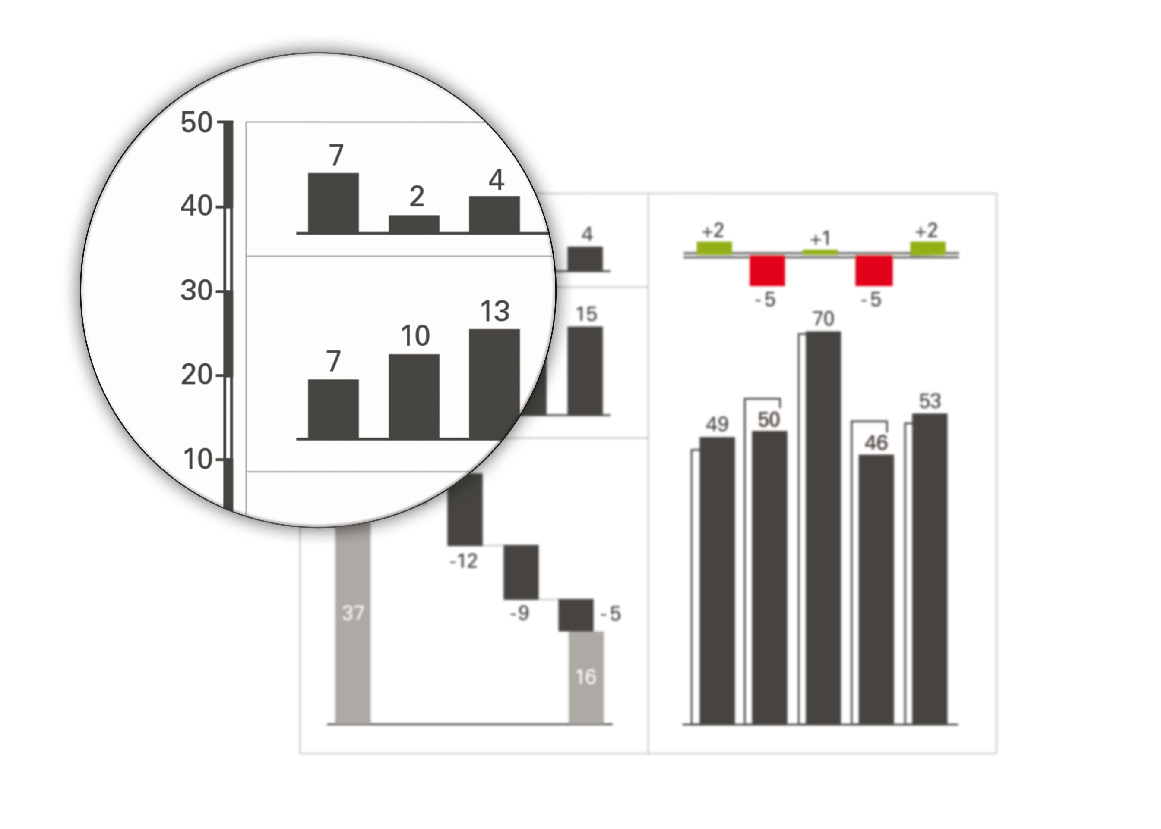
Same measurement units visible at a glance shall be scaled identically. If not possible, a scale band shall indicate the relation between the different scales.
7
www.ibcs.com

Slide 56
Alpha Corporation
Net sales in mUSD
2023
+33
+13
+12
+8
+12
+3
+5
+4
ΔPL%
-1
-6
-19
-18
+30
+65
+96
+157
+59
ΔPL
+23
+37
-44
-5
+85
-140
-131
899
827
844
809
AC
783
749
715
710
685
601
627
572
FC
PL
Jan
Feb
Mar
Apr
May
Jun
Jul
Aug
Sep
Oct
Nov
Dec
© www.ibcs.com

Slide 57
Alpha Corporation
Net sales in mUSD
2023
+33
+13
+12
+8
+12
+3
+5
+4
ΔPL%
-1
-6
-19
-18
+30
+65
+96
+157
+59
ΔPL
+23
+37
-44
-5
+85
-140
-131
899
827
844
809
AC
783
749
715
710
685
601
627
572
FC
PL
Jan
Feb
Mar
Apr
May
Jun
Jul
Aug
Sep
Oct
Nov
Dec
2023
© www.ibcs.com

Slide 58
Alpha Corporation
Net sales in mUSD
2023
+33
+13
+12
+8
+12
+3
+5
+4
+3
ΔPL%
-1
-6
-19
-18
+30
+65
+96
+250
+157
+59
ΔPL
+23
+37
-44
-5
+85
-140
-131
899
827
844
809
AC
783
749
8 821
715
710
685
601
627
572
3 621
FC
FC
PL
5 200
AC
Jan
Feb
Mar
Apr
May
Jun
Jul
Aug
Sep
Oct
Nov
Dec
2023
© www.ibcs.com

Slide 59
Alpha Corporation
Net sales in mUSD
2023
+33
+13
+12
+8
+12
+3
+5
+4
+3
ΔPL%
-1
-6
-19
-18
+30
+65
+96
+250
+157
+59
ΔPL
+23
+37
-44
-5
+85
-140
-131
899
827
844
809
AC
783
749
8 821
715
710
685
601
627
572
3 621
FC
FC
PL
5 200
AC
Jan
Feb
Mar
Apr
May
Jun
Jul
Aug
Sep
Oct
Nov
Dec
2023
© www.ibcs.com

Slide 60
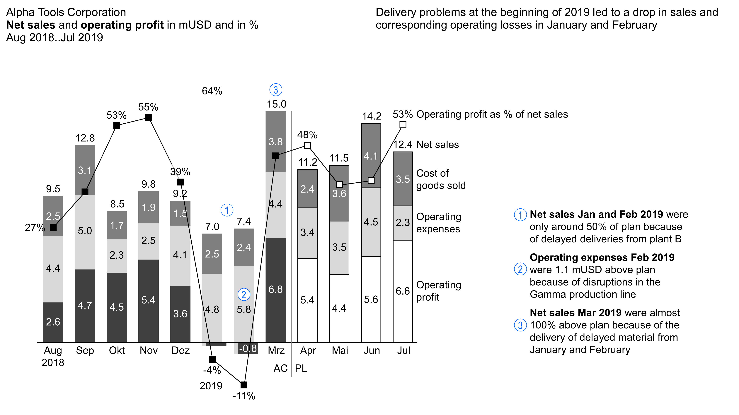
www.ibcs.com

Slide 61
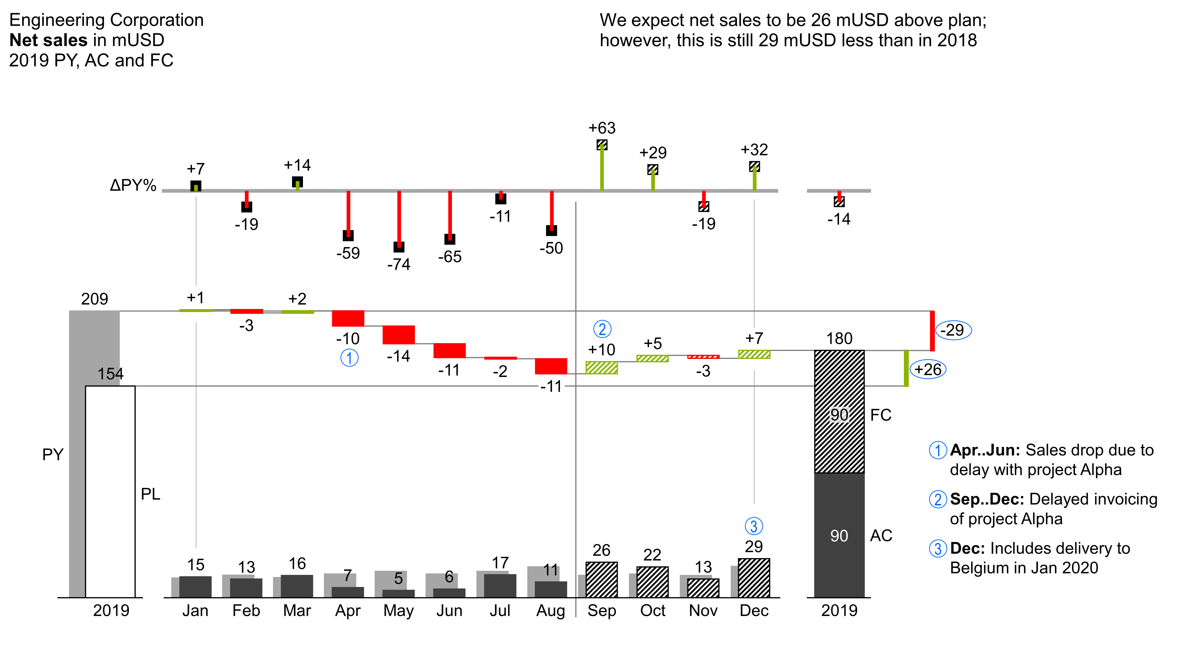
www.ibcs.com

Slide 62
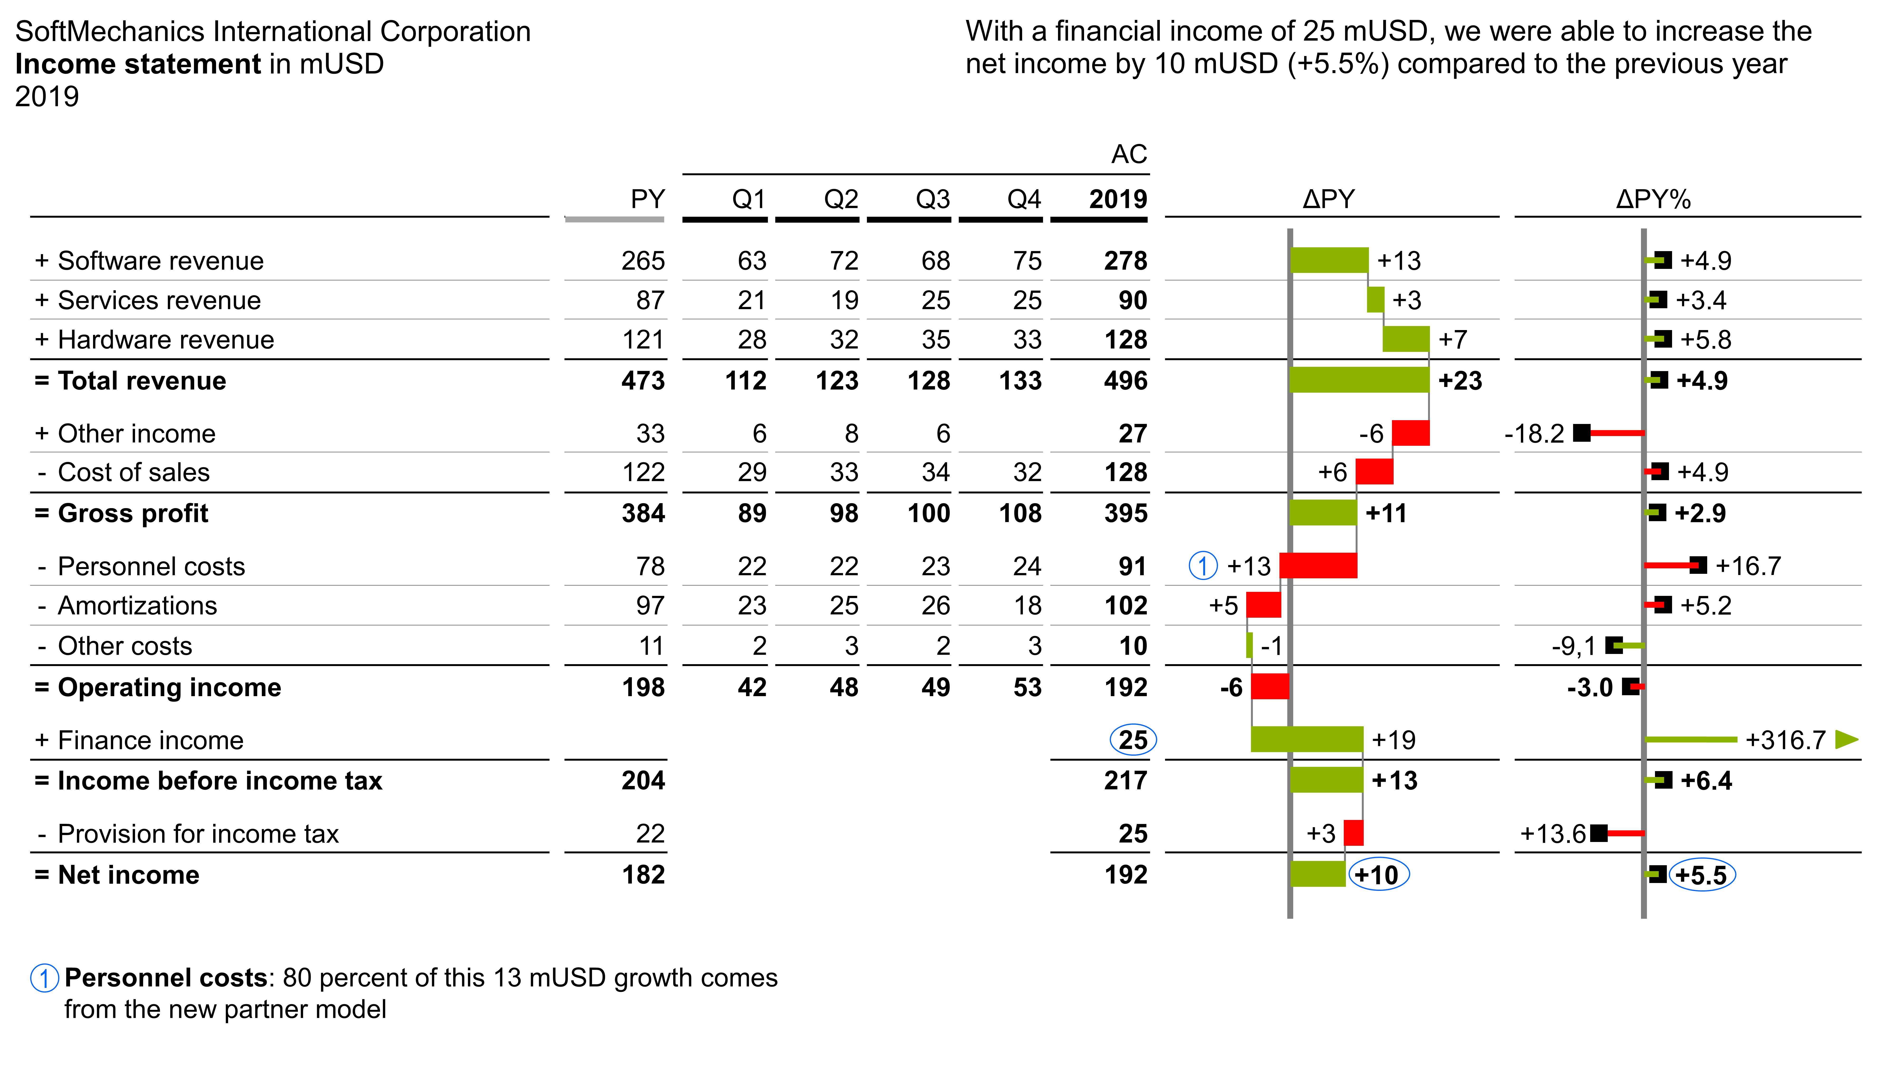
www.ibcs.com

Slide 63
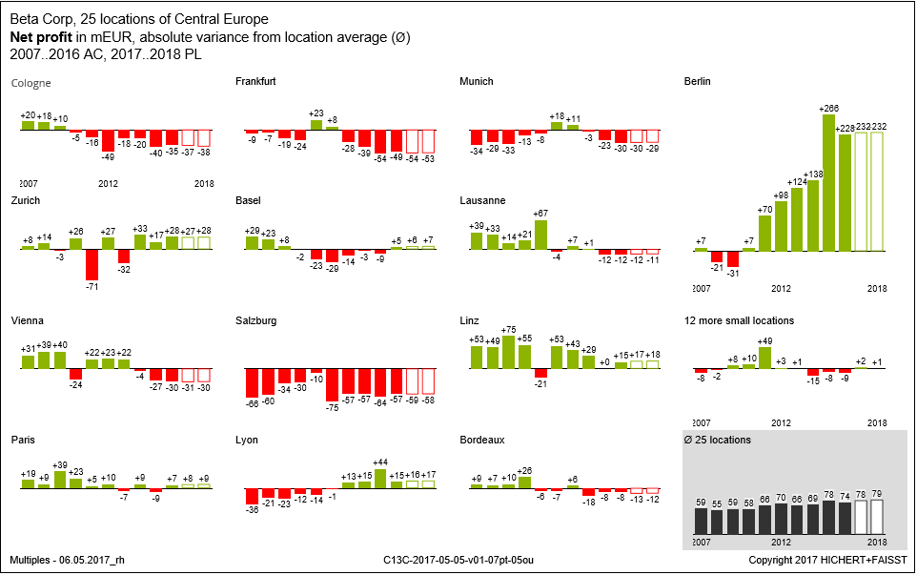
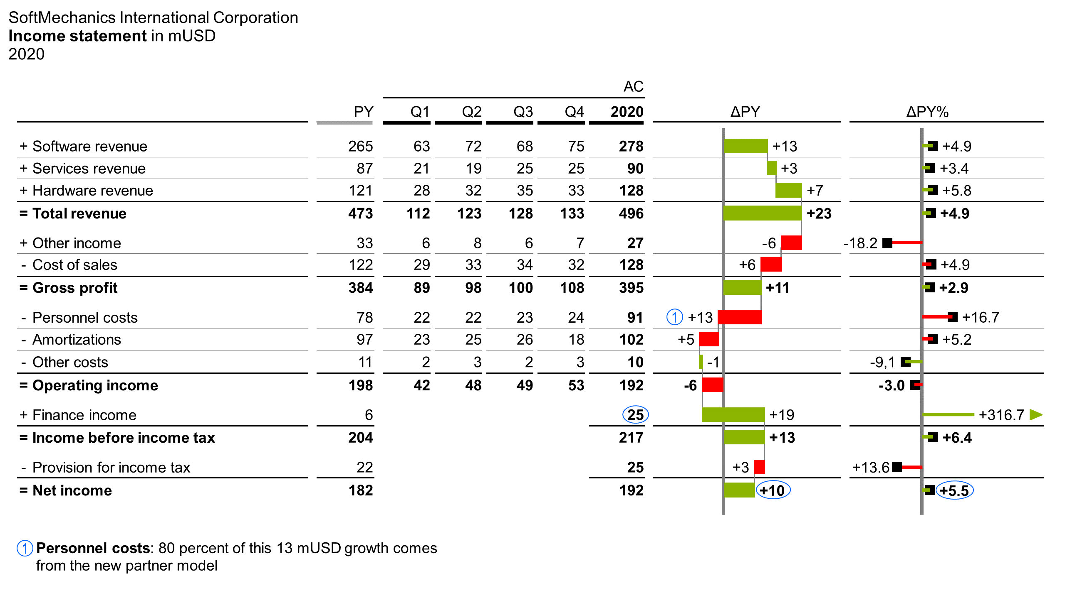
www.ibcs.com

Slide 64
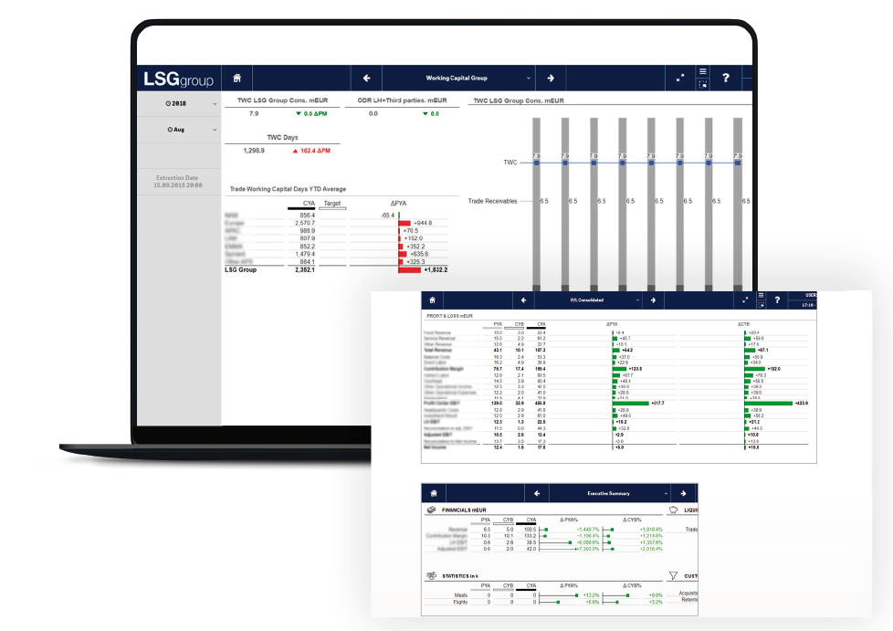
www.ibcs.com

Slide 65
www.ibcs.com

Slide 66
www.ibcs.com

Slide 67
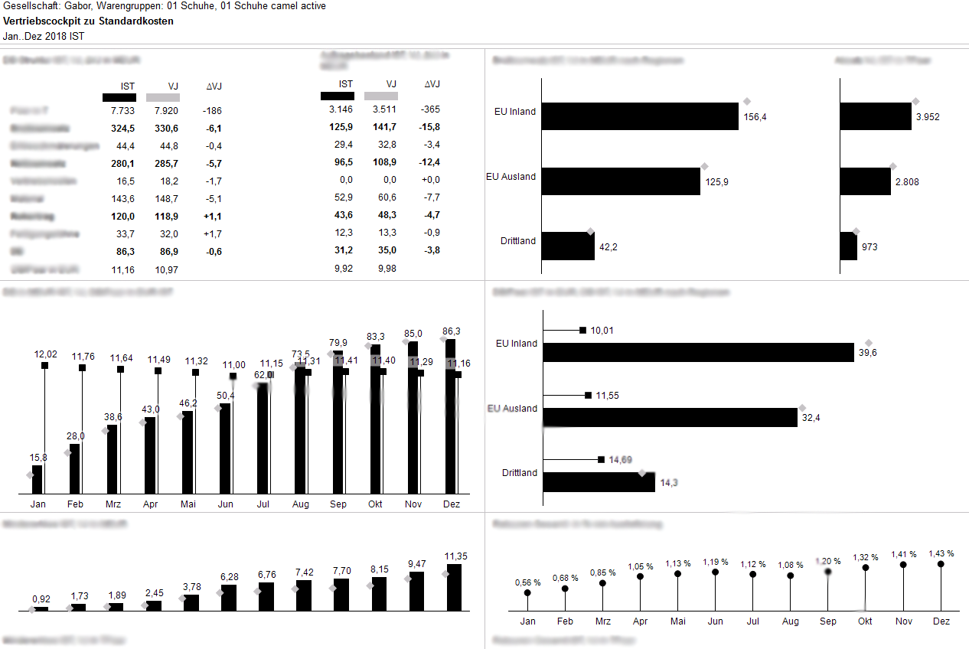
www.ibcs.com

Slide 68
www.ibcs.com

Slide 69
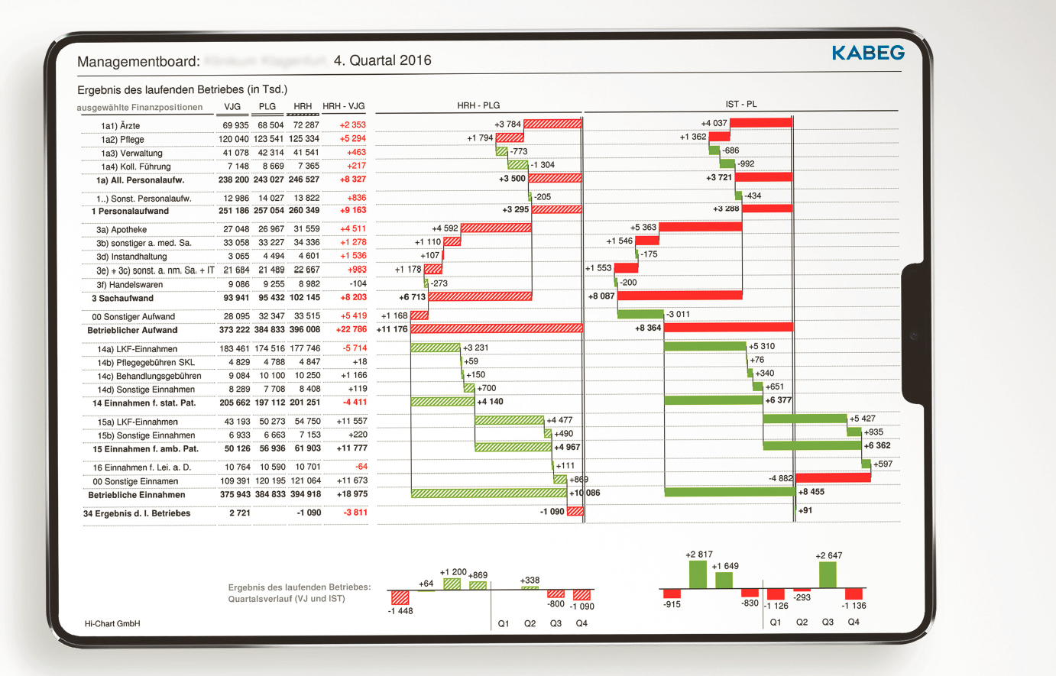
www.ibcs.com

Slide 70
www.ibcs.com

Slide 71
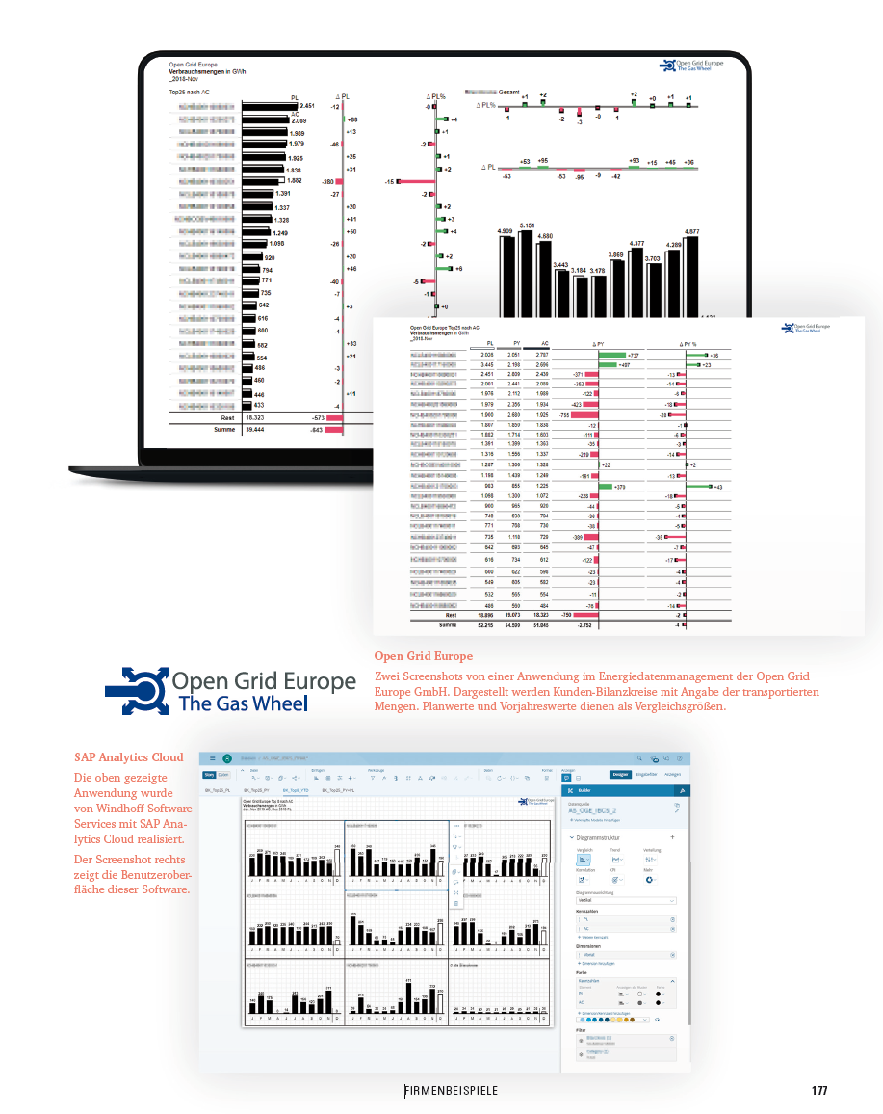
www.ibcs.com

Slide 72
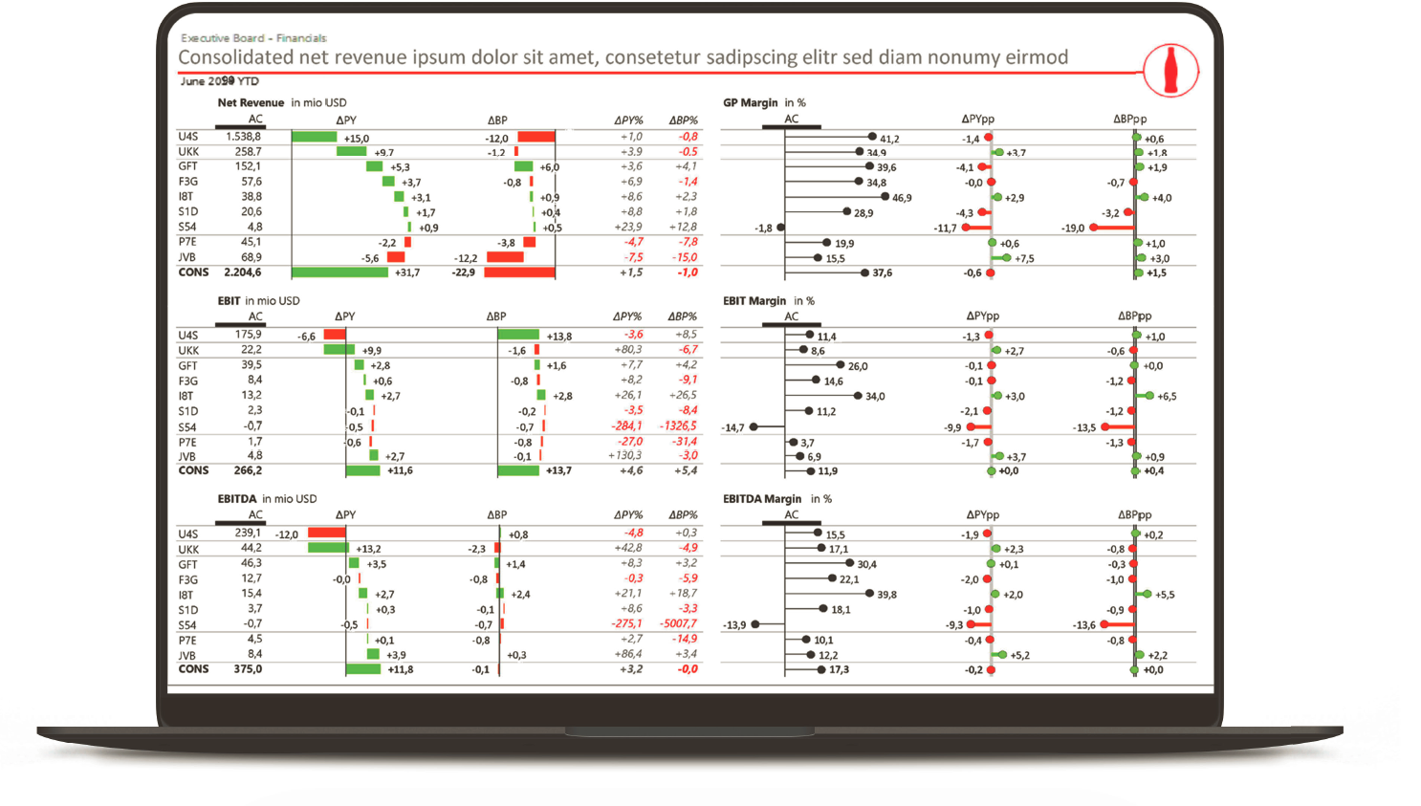
www.ibcs.com

Slide 73
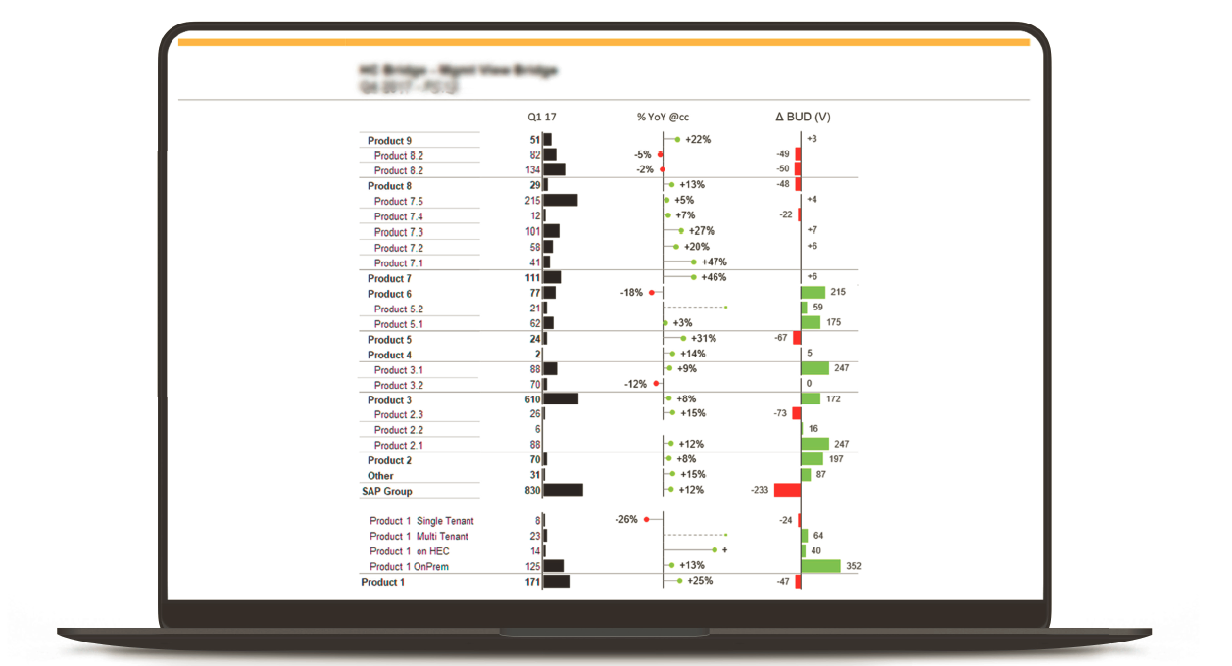
www.ibcs.com

Slide 74
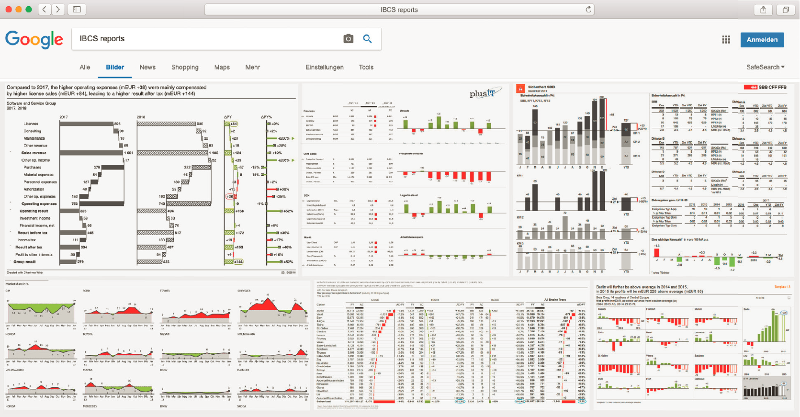

Slide 76
IBCS Certified Software
www.ibcs.com

Slide 77
IBCS
ISO/TC 37 NWIP
Report notation guidelines, since 2013
Current version, IBCS Version 1.2
Community driven, public consultation (10.000 members of IBCS Association)
Adopted by many businesses and >12 analytic software vendors
Published under Creative Commons (CC BY-SA)
NWIP for a certifiable ISO international standard to be developed under ISO/TC37
Proposed by DIN (Germany) and IPQ (Portugal) with IBCS Association as a formal A-Liaison
NWIP Pre-Expert Draft available

Slide 78
A Standard Notation for
Business Reports
Pre-expert draft
Q&A
Is this initiative of interest to ISO/TC37?
What are the next steps?

Slide 79
Resources for further information on benefits of a standardised report notation
Videos
Explanatory video: https://youtu.be/VkCyNOioUQQ
Introductory lesson to video course “Solid, outlined, hatched”: https://ibcs.teachable.com/courses/solid-outlined-hatched/lectures/15948252
Books
IBCS Version 1.2: https://geni.us/standards_ibcs (also available in Spanish language)
Solid, outlined, hatched – How visual consistency helps better understand reports, presentations and dashboards: https://geni.us/soh_ibcs (also available in German language)

